Slide 1

Shaping the Future of Cybersecurity Education
Is N.I.C.E.
NATIONAL INITIATIVE FOR CYBERSECURITY EDUCATION (NICE)
October 2010
Notes:
- Introduce self and position
Set the stage – already been briefed on the NCEI (touch on briefly) and Track 4/functional area Specialized skills
- Information new, ascertained from unique position – focusing on political climate for moving forward.

Slide 2






Why is Cybersecurity Such a Hot Topic?
Everyone is connected
Not everyone plays by the rules
Not everyone knows the rules
Not all situations have rules yet
Our thirst for technology is . . .
Notes:
2
Comparison of 8 and NCEI – strategic direction

Slide 3
THEPRESENT
Comprehensive
National
Cybersecurity
Initiative
Initiative #8, Expand Cyber Education
Training the existing federal cyber workforce in specialized skills and ensuring a federal cybersecurity workforce pipeline for the future.
Notes:
3
Comparison of 8 and NCEI – strategic direction

Slide 4
60 Day Cyber Review
Building Capacity for a Digital Nation
  Promote cybersecurity risk awareness for all citizens;
  Build an education system that will enhance understanding of cybersecurity and allow the United States to retain and expand upon its scientific, engineering, and market leadership in information technology;
  Expand and train the workforce to protect the Nation’s competitive advantage; and
  Help organizations and individuals make smart choices as they manage risk. 60-Day Cyber Review
Notes:
4

Slide 5









THEVISION
(U) National Initiative for Cybersecurity
Education
“…a national campaign to promote
cybersecurity awareness and digital literacy
from our boardrooms to our classrooms, and to build a digital workforce for the 21st century.”
President Barack Obama, 29 May 2009
Notes:
5
Comparison of 8 and NCEI – strategic direction
“a national campaign to promote cybersecurity awareness and digital literacy from our boardrooms to our classrooms, and to build a digital workforce for the 21st century.” President Barack Obama, 29 May 2009

Slide 6
Expanded Focus of NICE
CNCI Initiative #8
National Education
Federal Focus
Federal Employee Awareness
Education/training
focused on filling
federal jobs
Federal Pipeline
National Focus
Public Awareness
K-12 and Higher Education
National Pipeline
6
Notes:
6

Slide 7


THEPATH
TRACK
National Cybersecurity Awareness – DHS
Public Service Campaigns
1
AWARENESS
TRACK
Formal Cybersecurity Education – ED [OSTP, DOL, DHS supporting]
STEM education programs related to cybersecurity
2
EDUCATION
TRACK
Federal Cybersecurity Workforce Structure – OPM [OMB, ODNI supporting]
Defined cybersecurity jobs, attract, recruit and retain strategies
3
STRUCTURE
TRACK
Cybersecurity Workforce Training and Professional Development
DoD, ODNI, DHS Tri-Leads
  General IT Use – DoD and DHS
  IT Infrastructure, Operations, Maintenance & Information Assurance – DoD, DHS
  Domestic Law Enforcement and Counterintelligence – Lead TBD
  Specialized Cybersecurity Operations – NSA
4
TRAINING

Slide 8
Initiative #8 - Achievements
  Building of federal training programs on a variety of computer network programs
  Workforce Development Plans (work roles, competencies, knowledge, skills, and abilities (KSAs); that have become part of the framework for the national effort.
  Centers of Academic Excellence for Information Assurance extension to Community Colleges
  Building the virtual cybersecurity training environment for the Federal Government
  Expansion of the DC3 organization’s computer forensic and analysis courses for the entire Federal government.
  Framework issues - identifying the main issues of workforce pipeline and need for consistent lexicon to build the national effort
Notes:
Initiative #8 Co-leads: DHS, NSA
Focused on specialized skills
Extremely successful
Building of federal training programs on a variety of computer network programs
Workforce Development Plans (work roles, competencies, knowledge, skills, and abilities (KSAs); that have become part of the framework for the national effort.
Centers of Academic Excellence for Information Assurance extension to Community Colleges
Building the virtual cybersecurity training environment for the Federal Government
Expansion of the DC3 organization’s computer forensic and analysis courses for the entire Federal government.
Framework issues - identifying the main issues of workforce pipeline and need for consistent lexicon to build the national effort

Slide 9



THE VISION
OVERALL LEAD: Cybersecurity Education
National Initiative for Cybersecurity Education
Lead:
National Institute of Standards and Technology –
Ernest McDuffie, PhD

Slide 10
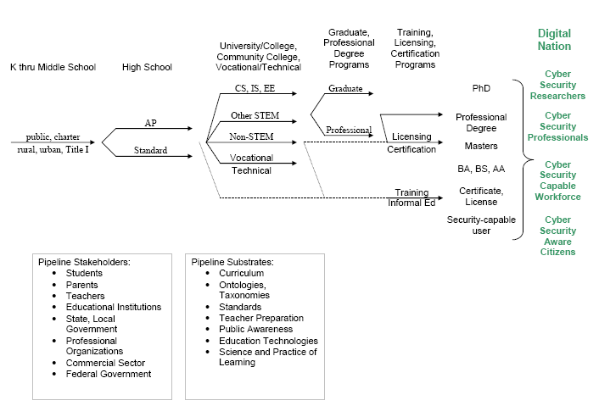
The Pipeline
10
Notes:
10

Slide 11


THE VISION
TRACK 1: Public Campaign
TRACK
1
AWARENESS
National Cybersecurity Awareness
Lead:
Department of Homeland Security – Tim Fraser

Slide 12

THE VISION
TRACK 2: K-12 & Higher Education
TRACK
2
EDUCATION
Formal Cybersecurity Education
Co-leads:
Department of Education – Bucky Methfessel
Office of Science and Technology Policy –
Chris Greer, PhD

Slide 13


THE VISION
TRACK 3: Recruitment, Hiring, Job-Series
TRACK
3
Cybersecurity Workforce Structure
Lead:
Office of Personnel Management – Maureen Higgins
STRUCTURE

Slide 14



THE VISION
TRACK 4: Training & Professional Development
TRACK
4
Cybersecurity Workforce Training and Professional Development
Tri-Leads: ODNI/CHCO – Jane Homeyer, PhD
DHS – Peggy Maxson
DOD – John Mills
Training

Slide 15
THE VISION
QUESTIONS?
Notes:
15
Provide brief summary of topics
Comprehensive National Cybersecurity Initiative
CNCI #8
CNCI #8 Path by 4 Tracks (Awareness, Education, Structure, Training)
Progress through CNCI8 Co-leads
History leading up to CNCI8 leadership across Tracks
Individual Tracks and related Co-Leads
Observations
Provide business cards and/or contact information
Give gratitude for audience time and attention

Slide 16
Contact Information
Dr. Ernest L. McDuffie
http://www.nist.gov/nice
Email: ernest.mcduffie@nist.gov
Phone: 301.975.8897

